Slide 1
Making Decisions: the Selection Structure
Chapter 3

Slide 2

3.1
What if? Types of Selection Structures

Slide 3
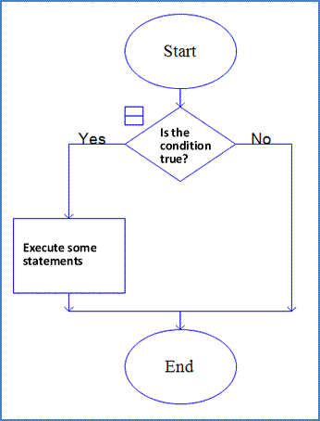
Single-alternative structures
Contains a single block of statements
If true, statements are executed
If not true, statements are skipped

Slide 4
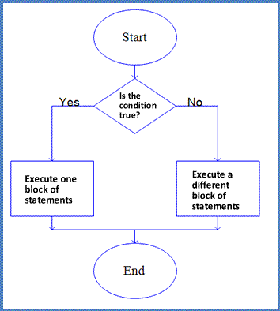
Dual-alternative structures
Contains two blocks of statements
If true, first block of statements is executed
If not true, second block of statements is executed

Slide 5
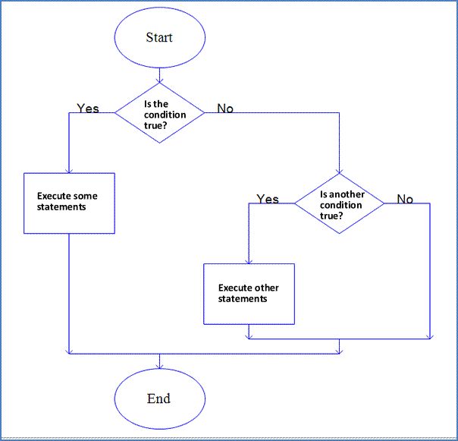
Multiple-alternative structures
Contains more than two blocks of statements
If true, first block of statements is executed
If not true, second condition is checked
If true, that block of statements is executed
If not true, another condition is checked
And so on…

Slide 6
3.2
The Single Alternative Structure: The if statement

Slide 7
General Form
if (test condition)
{
statement;
statement;
.
.
.
statement;
}

Slide 8
Example: Is it snowing?
function getTemp()
{
var temp = prompt("What's the temperature today?","degrees F");
if (temp < 32)
{
document.write("<p>It may snow today!</p>");
}
Will display only if temperature < 32⁰
Note: will not display if temperature = 32
Curly brackets { } are optional when there is only one statement in the if block

Slide 9
Example: Is it snowing?
function getTemp()
{
var temp = prompt("What's the temperature today?","degrees F");
if (temp < 32)
{
document.write("<p>It may snow today!</p>");
document.write("<p>"Be sure to wear your boots 
and mittens.</p>");
}
Will display only if temperature < 32⁰
Note: will not display if temperature = 32
Curly brackets { } are necessary when there are more than one statement in the if block!

Slide 10
3.3
The Dual-Alternative Structure: if…else Statements

Slide 11
General Form
if (test condition)
{
statement;
statement;
.
.
.
statement;
}
else
{
statement;
statement;
.
.
.
}

Slide 12
Example: Getting Extra Credit
1. function getScore()
2. { 3. var basicScore = parseInt(prompt("What was student's 
score?"," "));
4. var extraQuestion = prompt("Did the student do Q. 21  (y/n)?"," ");
5. if (extraQuestion == "yes") 6. var points = parseInt(prompt("How many points did
the student earn on Q. 21?"," "));
7. else 8. var points = parseInt(prompt("How many points did
student earn for study guide?"," "));
9. var score = basicScore + points;
10. document.write("<p>Score, with anyt extra credit, 
is " + score + "%.</p>");
11. }

Slide 13
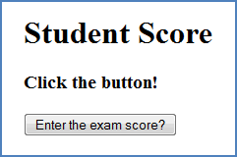



Display
Initial display:
Student: 83%, 8 points for Q. 21:
Student: 83%, no Q. 21 but has study guide:
Student: 83%, no Q.21, and no study guide:
What if student answers Q. 21 and hands in the study guide? Will use a compound condition.

Slide 14
3.4
Nested Selection Structures

Slide 15
General Form
if (test condition1)
{
if (test condition2)
{
block of statements to be executed if both condition1 and
condition2 are true;
}
else
{
block of statements to be executed if condition1 is true
but condition2 is not true;
}
}
else
{
block of statements to be executed if condition1 is false;
}

Slide 16
3.5
Compound Conditions

Slide 17
Logical Operators (revisited)
The result of an expression with logical operators is always either true or false
The AND operator is written as &&
Always results in false unless both sides of the expression are true
The OR operators is written as ||
Always results in true unless both sides of the expression are false
The NOT operator is written as !
It is true if the expression is false and false if the expression is true

Slide 18
Syntax for Writing Compound Conditions
if (condition 1 && condition 2)
Must write a complete condition each time. The entire compound condition must be enclosed within the parentheses and, for each condition, the whole condition, including the variable, the relational operator, and the test, must be included.
Would not work: if (price > 5 && < 12)
Would not work: if (price > 5) && (price < 12)
Correct syntax: if (price > 5 && price < 12)

Slide 19
Using AND and OR
Most of the time either operator, so long as the conditions are written carefully, can work in a given situation.
Example: to allow only the integers 6, 7, 8, and 9 to be true:
Use the AND operator to specify that any integer greater than 5 and less than 10 is acceptable.
(num > 5 && num < 10)
This is true if num is 6, 7, 8, or 9.
Use the OR operator to specify that any integer less than or equal to 5 or greater than or equal to 10 is false. Then use the NOT operator to make it true when num is 6, 7, 8, or 9.
!(num <= 5 || num >= 10)
Both produce the same result.

Slide 20
Calculating overtime pay with the AND operator
1.function paycheck() 2.{ 3. var rate = parseInt(prompt("What is the employee's pay
rate?"," "));
4. var hours = parseInt(prompt("How many hours did the
employee work this week?"," "));
5. if (hours > 40 && rate < 20) 6. { 7. var overtime = rate * 1.5 * (hours - 40); 8. var regular = rate * 40; 9. var pay = overtime + regular; 10. } 11. else 12. var pay = rate * hours; 13. document.write("<p>Your paycheck this week will be $ " +
pay + ".</p>");
14.}

Slide 21
Calculating overtime pay with the OR operator
1.function paycheck() 2.{ 3. var rate = parseInt(prompt("What is the employee's pay
rate?"," "));
4. var hours = parseInt(prompt("How many hours did the
employee work this week?"," "));
5. if (hours <= 40 || rate >= 20) 6. var pay = rate * hours; 7. else 8. { 9. var overtime = rate * 1.5 * (hours - 40); 10. var regular = rate * 40; 11. var pay = overtime + regular; 12. }
13. document.write("<p>Your paycheck this week will be $ " +
pay + ".</p>");
14.}

Slide 22
3.6
Multiple-Alternative Selection Structures

Slide 23
General Form: The if...else if... Structure
if (test condition 1)
{ statements to be executed; } else if (test condition 2) { statements to be executed; } else { statements to be executed if neither condition
1 nor condition 2 are true;
}

Slide 24
Example: A Rating System Using the if...else if... Structure
1. function rateIt() 2. { 3. var rate = parseInt(prompt("Rate the site from 1 to 10,
with 10 as the best"," "));
4. var grade = " " 5. if (rate == 10) 6. grade = "A"; 7. else if (rate >= 7 && rate <= 9) 8. grade = "B"; 9. else if (rate >= 4 && rate < 7) 10. grade = "C"; 11. else 12. grade = "D"; 13. document.write("<p>You gave the site a rating of " +
grade + ".</p>");
14. }

Slide 25
General Form: The switch Structure
switch(test expression) { case 1: execute code block 1 break; case 2: execute code block 2 break; .
...all other cases and code to be executed
.
case n: execute code block n
break; default:
code to be executed is nothing matches the test condition }

Slide 26
Example: A Rating System Using the switch Structure
1. function rateIt() 2. { 3. var rate = parseInt(prompt("Rate the site from 1 to 10, 10 as the best"," "));
4. var grade = " “; 5. switch (rate) 6. { 7. case 10: 8. grade = "A"; 9. document.write("<p>You gave the site a rating of "+ grade + ".</p>");
10. break; 11. case 9: case 8: case 7: 12. grade = "B"; 13. document.write("<p>You gave the site a rating of "+ grade + ".</p>");
14. break; 15. case 6: case 5: case 4: 16. grade = "C"; 17. document.write("<p>You gave the site a rating of " + grade + ".</p>");
18. break; 19. case 3: case 2: case 1: 20. grade = "D"; 21. document.write("<p>You gave the site a rating of “ + grade + ".</p>");
22. break; 23. default: 24. document.write("<p>Invalid entry</p>"); 25. } 26. }

Slide 27
Notes re: the switch Structure
Without the break statement, all following cases will execute!
1. function colorIt() 2. { 3. var color = parseInt(prompt(“Enter 1 for red, 2 for
blue, 3 for yellow"," "));
4. switch (color) 5. { 6. case 1: 7. document.write("<p>You like red.</p>");
8. case 2: 9. document.write("<p>You like blue.</p>");
10. case 3: 11. document.write("<p>You like yellow.</p>");
12. default: 13. document.write("<p>Invalid entry</p>"); 14. } 15. }

Slide 28
Results
Entering a 1 will result in:
You like red.
You like blue.
You like yellow. Invalid entry
Entering a 2 will result in:
You like blue.
You like yellow. Invalid entry
Entering a 3 will result in:
You like yellow. Invalid entry
Entering anything else will result in:
Invalid entry

